Slide 1
Autonomous Indoor Gardening
Thanushanth K
200636H

Slide 2
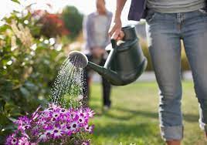
Problem
The problem addressed by the Autonomous Indoor Gardening System lies in the challenges faced by indoor plant enthusiasts in providing consistent and optimal care to their plants.
Many people struggle to maintain a green and healthy indoor garden due to busy schedules, lack of gardening expertise, or difficulties in keeping track of the ever-changing needs of different plant species.
Manual watering and adjusting environmental conditions can be time-consuming and prone to human error, leading to either overwatering or underwatering, inadequate light exposure, and improper temperature and humidity levels. These issues often result in stressed and withering plants, leaving users frustrated and discouraged.

Slide 3
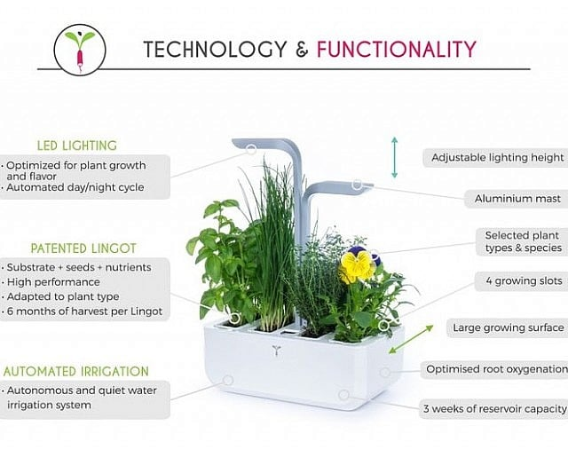
Solution
The proposed solution is an innovative self-sustaining indoor gardening system that automates essential plant care tasks and optimizes environmental conditions for optimal plant growth.
Integrating a network of sensors, actuators, and a central microcontroller, the system can continuously monitor key parameters like soil moisture, light intensity, temperature, and humidity. Based on real-time data, the microcontroller employs predefined algorithms to make informed decisions.
It triggers actuators such as a smart watering system, adjustable LED lights, and climate control mechanisms to ensure the plants receive the right amount of water, light, and an ideal indoor climate.
Additionally, users can control and monitor the entire system remotely through a user-friendly mobile app, empowering them to customize settings, receive real-time updates on plant health, and even intervene when necessary.

Slide 4
Implementation
The Autonomous Indoor Gardening System's hardware implementation comprises sensors, actuators, and a microcontroller, all integrated within a robust enclosure suitable for indoor use. Soil moisture sensors accurately measure the soil's moisture content, while light sensors assess the intensity and duration of light exposure.
Temperature and humidity sensors monitor the indoor climate. An intelligent microcontroller, such as Arduino or Raspberry Pi, collects and processes data from the sensors, making use of programmed algorithms. The microcontroller then activates the watering system to provide the right amount of water when soil moisture is low.
It adjusts the intensity and duration of LED lights to mimic natural sunlight and meets the specific plant requirements. Climate control devices, such as fans or humidifiers, are activated to maintain the optimal temperature and humidity range.
The system's software includes a user-friendly mobile app that connects to the microcontroller through a secure internet connection. The app allows users to remotely access and control the indoor gardening system. They can view real-time data on plant health and environmental conditions, adjust watering schedules, light settings, and even set personalized care plans for different plant species.
The system's continuous data collection, processing, and feedback loop ensure that the plants thrive and users can enjoy a flourishing indoor garden without the need for constant manual intervention.

